Slide 1
CS 4032 – Web Programming
Dr. Hassan Sartaj

Slide 2
Maintaining State in HTTP

Slide 3
BROWSER
SERVER
HTML
ASP.Net
HTTP
Hyper Text Transfer Protocol
CSS
PHP
SQL
How stuff gets back and forth...
How stuff gets made and stored
How stuff looks
For each of these aspects of the web, we have many standards and languages and techniques to learn.

Slide 4

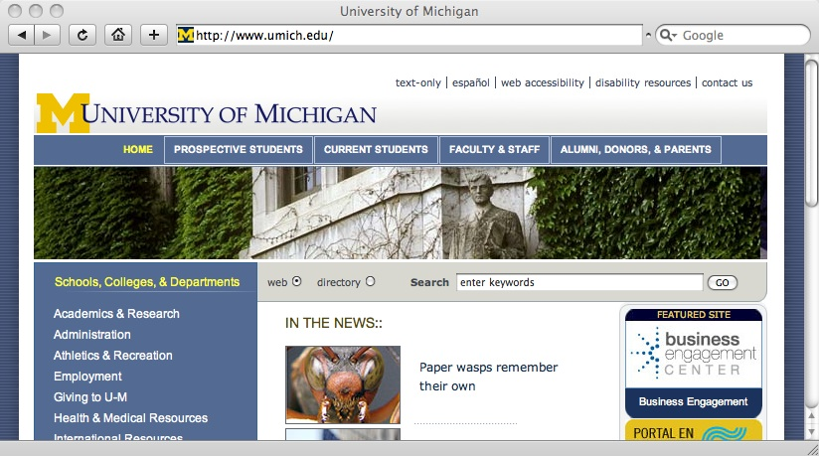
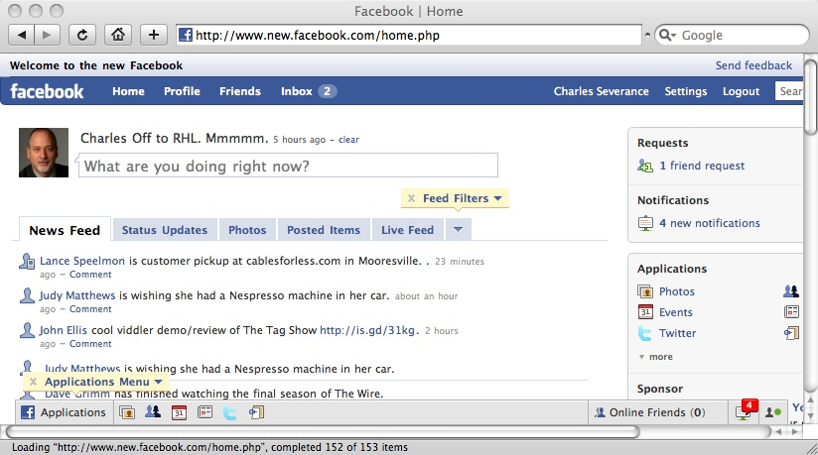
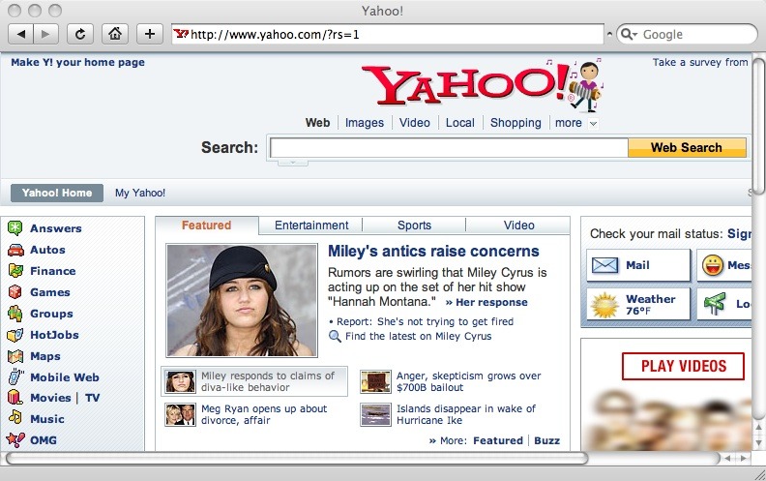

www.umich.edu
www.facebook.com
www.yahoo.com
29
times
images.yahoo.com
The read-only web: hypertext navigation and lots of GETs
(Screenshot) Source: www.facebook.com
(Globe) source: http://www.clker.com/clipart-2123.html
(Server) source: http://www.clker.com/clipart-server.html

Slide 5
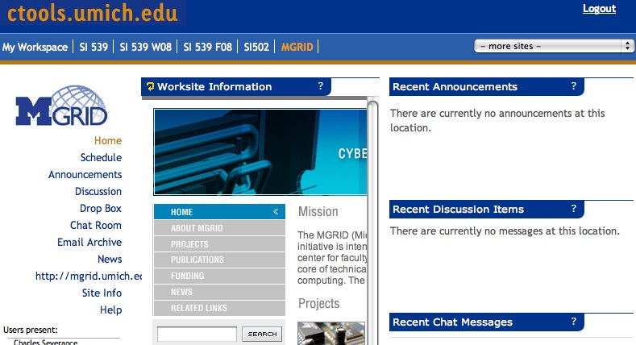
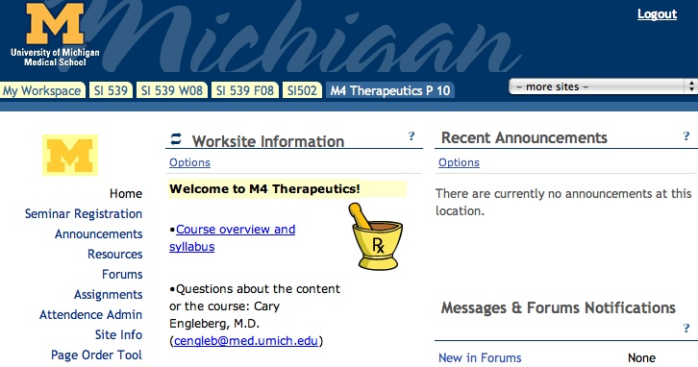
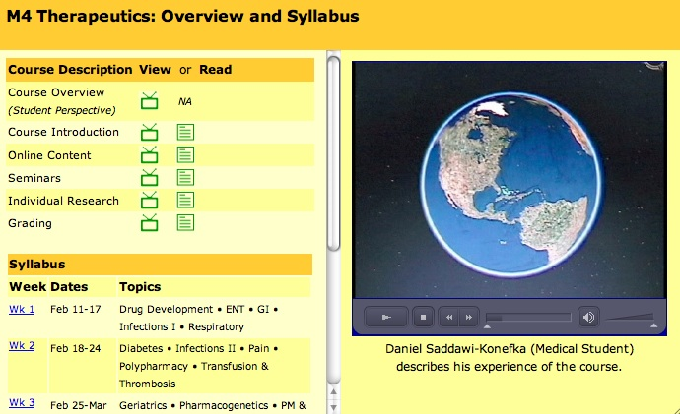
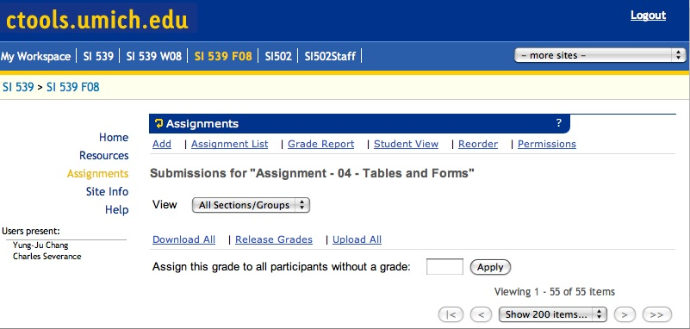
ctools.umich.edu
Servers get used by many users at the same time.

Slide 6
???
ctools.umich.edu
When folks hit a button...
everyone POSTs

Slide 7
Server Questions ???
Who is this user?
Are they logged in yet?
What screen did they come from?
What button did they push?
Where do we store this data?
What screen do they want next?

Slide 8
Server Questions ???
Who is this user?
Are they logged in yet?
What screen did they come from?
What button did they push?
Where do we store this data?
What screen do they want next?
Over and over and over and over and over and over and over....
same as it ever was

Slide 9
Cookies and Sessions Maintaining State in HTTP

Slide 10
High Level Summary
The web is “stateless” - the browser does not maintain a connection to the server while you are looking at a page. You may never come back to the same server - or it may be a long time - or it may be one second later
So we need a way for servers to know “which browser is this?”
In the browser state is stored in “Cookies”
In the server state is stored in “Sessions”

Slide 11
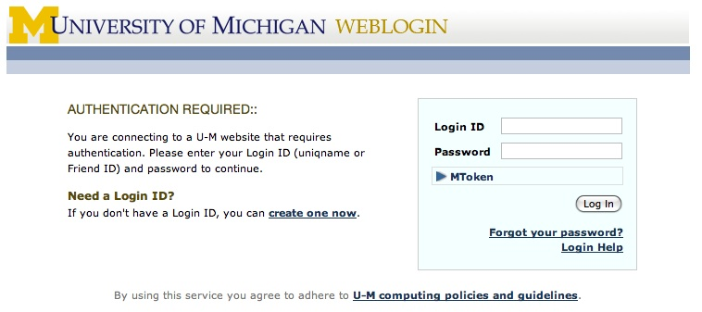
Some Web sites always seem to want to know who you are!

Slide 12
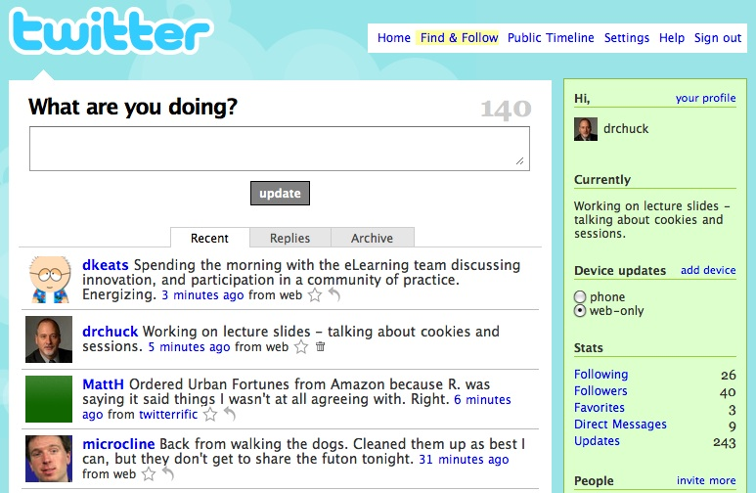
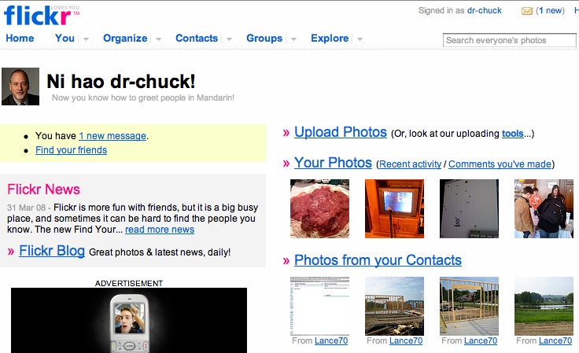
Other Web sites always seem to know who you are!

Slide 13
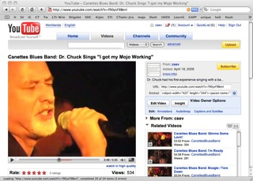
Browser
Click
Draw
Click
Draw
You watch the YouTube video
for 30 seconds
Whole
Page
Whole
Page
GET
GET
Server
How you see YouTube...

Slide 14
Browser
Click
Draw
Click
Draw
Whole
Page
Whole
Page
GET
GET
Server
How YouTube sees you...

Slide 15
Multi-User
When a server is interacting with many different browsers at the same time, the server needs to know *which* browser a particular request came from
Request / Response initially was stateless - all browsers looked identical - this was really bad and did not last very long at all

Slide 16
Web Cookies to the Rescue
Technically, cookies are arbitrary pieces of data chosen by the Web server and sent to the browser. The browser returns them unchanged to the server, introducing a state (memory of previous events) into otherwise stateless HTTP transactions. Without cookies, each retrieval of a Web page or component of a Web page is an isolated event, mostly unrelated to all other views of the pages of the same site.

Slide 17
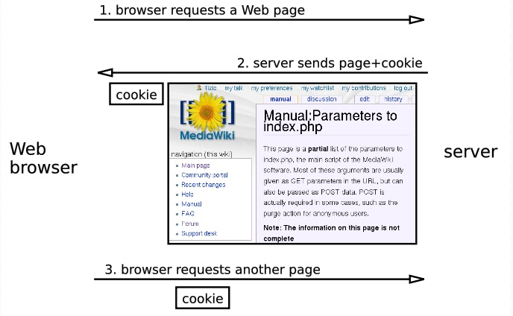

Slide 18
Cookies In the Browser
Cookies are marked as to the web addresses they come from
The browser only sends back cookies that were originally set by the same web server
Cookies have name and data
Data size limited by browsers (typically < 4 KB)
A server can define multiple cookies with different names, but browsers limit the number of cookies per server (around 50)
Cookies have an expiration date
Some last for years
Others are short-term and go away as soon as the browser is closed

Slide 19
Playing with Cookies
Firefox Developer Plugin has a set of cookie features
Other browsers have a way to view or change cookies

Slide 20
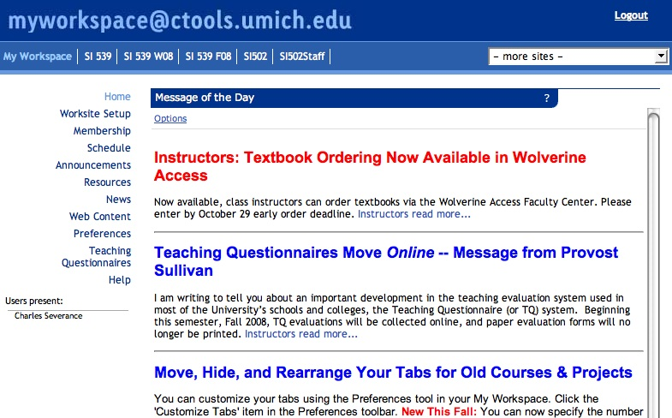
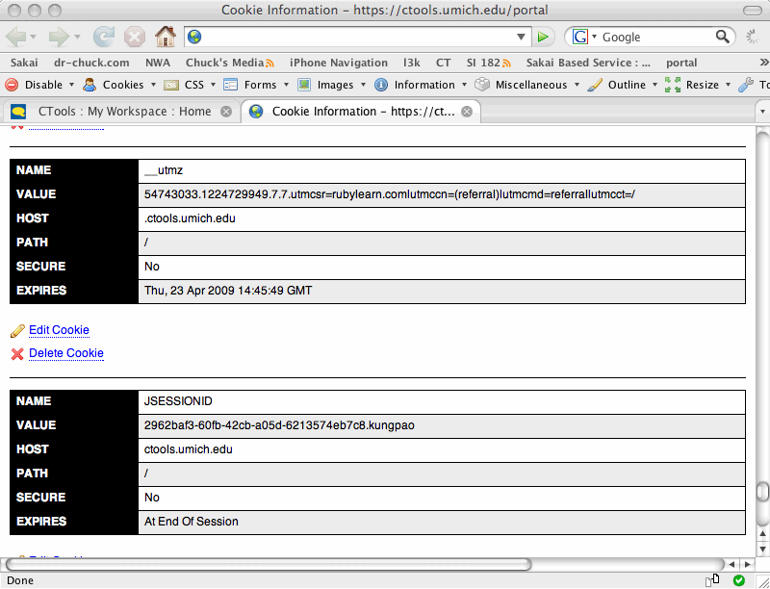

Slide 21
Two Kinds of Cookies
Two kinds of cookies
Long-lived - who you are - account name last access time - you can close and reopen your browser and it is still there
Temporary - used to identify your session - it goes away when you close the browser

Slide 22
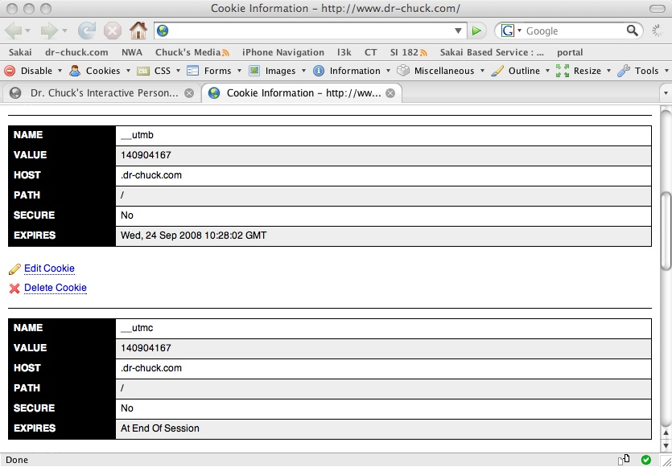

The Firefox Web Developer Plugin Shows Cookies for the Current Host.

Slide 23
Google Analytics Cookies

Slide 24
Myths and Facts about Cookies
Myths:
Cookies are like worms/viruses and can erase data from the user's hard disk.
Cookies are a form of spyware and can steal your personal information.
Cookies generate popups and spam.
Cookies are only used for advertising.
Facts:
Cookies are only data, not program code.
Cookies cannot erase or read information from the user's computer.
Cookies are usually anonymous (do not contain personal information).
Cookies CAN be used to track your viewing habits on a particular site.

Slide 25
Request Response Again! This time with cookies...

Slide 26
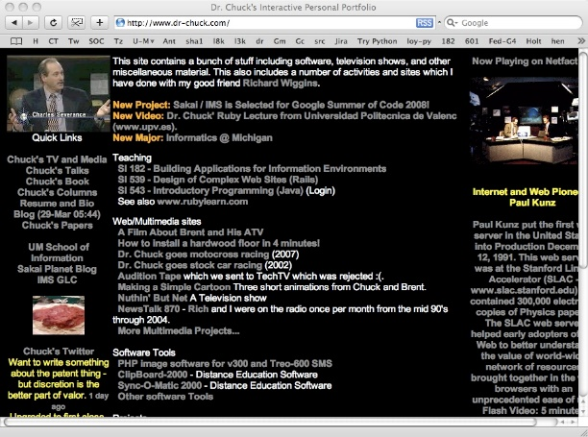

HTTP Request / Response Cycle
Web Server
(Review)
HTTP
Request
HTTP
Response
Browser
Internet Explorer, FireFox, Safari, etc.

Slide 27
HTTP Request / Response Cycle
Web Server
We do or initial
GET to a server. The server checks to see if we have a cookie with a particular name set.
Since this our first interaction, we do not have cookies set for this host.
GET /index.html HTTP/1.1
Accept: www/source
Accept: text/html
User-Agent: Lynx/2.4
Browser
HTTP
Request

Slide 28
HTTP Request / Response Cycle
Web Server
HTTP/1.1 200 OK Content-type: text/html Set-Cookie: sessid=123
<head> .. </head>
<body>
<h1>Welcome ....
Along with the rest of the response, the server sets a cookie with some name (sessid) and sends it back along with the rest of the response.
Browser
HTTP
Response
host: sessid=123

Slide 29
HTTP Request / Response Cycle
Web Server
GET /index.html HTTP/1.1
Accept: www/source
Accept: text/html
Cookie: sessid=123
User-Agent: Lynx/2.4
From that point forward, each time we send a GET or POST to the server, we include any cookies which were set by that host.
Browser
HTTP
Request
host: sessid=123

Slide 30
HTTP Request / Response Cycle
Web Server
HTTP/1.1 200 OK Content-type: text/html Set-Cookie: name=chuck
<head> .. </head>
<body>
<h1>Welcome ....
On each response, the server can change a cookie value or add another cookie.
Browser
host: sessid=123
host:name=chuck
HTTP
Response

Slide 31
HTTP Request / Response Cycle
Web Server
GET /index.html HTTP/1.1
Accept: www/source
Accept: text/html
Cookie: sessid=123,name=chuck
User-Agent: Lynx/2.4
From that point forward, each time we send a GET or POST to the server, we include all the cookies which were set by that host.
Browser
HTTP
Request
host: sessid=123
host:name=chuck

Slide 32
Browser
Page
Page
Page
Cookies
Cookies
Cookies
GET
GET
POST
Server
Remember that cookies are only sent back to the host that set the cookie.

Slide 33
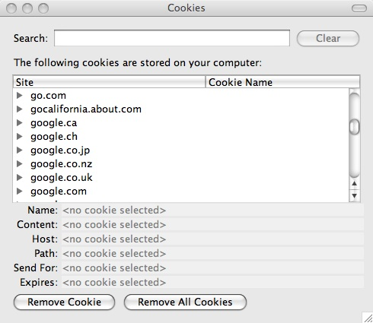
Security
We only send cookies back to the host that originally set the cookie
The browser has *lots* of cookies for lots of hosts
To see all Cookies: Firefox -> Preferences -> Privacy -> Show Cookies

Slide 34
Using Cookies to Support Sessions and Login / Logout

Slide 35
Some Web sites always seem to want to know who you are!

Slide 36
In The Server - Sessions
In most server applications, as soon as we meet a new browser - we create a session
We set a session cookie to be stored in the browser which indicates the session id in use
The creation and destruction of sessions is generally handled by a web framework or some utility code that we just use to manage the sessions

Slide 37
Session Identifier
A large, random number that we place in a browser cookie the first time we encounter a browser.
This number is used to pick from the many sessions that the server has active at any one time.
Server software stores data in the session which it wants to have from one request to another from the same browser.
Shopping cart or login information is stored in the session in the server

Slide 38
Server
Browser C

Slide 39
Server
Request
Browser C

Slide 40
Server
Session 97
Create
Session
Request
index:
“Please
log in”
Browser C
cook=97
cook=97
Response

Slide 41
Source: https://weblogin.umich.edu/
Server
Session 97
Typing
We now have a session established
but are not yet logged in.
Browser C
cook=97

Slide 42
Login / Logout
Having a session is not the same as being logged in.
Generally you have a session the instant you connect to a web site
The Session ID cookie is set when the first page is delivered
Login puts user information in the session (stored in the server)
Logout removes user information from the session

Slide 43
Server
Session 97
Request
cook=97
login:
if good:
set user
Browser C
cook=97
Click

Slide 44
Server
Session 97
user=phil
Request
cook=97
login:
if good:
set user
Browser C
cook=97
Click
Response

Slide 45
Server
Session 97
user=phil
Browser C
cook=97

Slide 46
Using Sessions for Other Stuff

Slide 47
Server
Browser A
cook=10
Session 10
user=chuck
bal=$1000
Session 46
user=jan
bal=$400
Browser B
cook=46

Slide 48
Server
Browser A
cook=10
Session 10
user=chuck
bal=$1000
Session 46
user=jan
bal=$500
Browser B
cook=46
withdraw:
bal=bal-100

Slide 49
Server
Browser A
cook=10
Session 10
user=chuck
bal=$1000
Session 46
user=jan
bal=$500
Browser B
cook=46
Click
withdraw:
bal=bal-100

Slide 50
Server
Browser A
cook=10
Session 10
user=chuck
bal=$1000
Session 46
user=jan
bal=$500
Browser B
cook=46
cook=46
withdraw:
bal=bal-100

Slide 51
Server
Browser A
cook=10
Session 10
user=chuck
bal=$1000
Session 46
user=jan
bal=$400
Request
Browser B
cook=46
cook=46
withdraw:
bal=bal-100
Response

Slide 52
Thank you!

